Slide 1

Lead Score Case Study
Contents
Problem Statement
Business Objective
Solution Approach
Summary
Pooja Goud
Ankit Gupta
Dilip Kumar

Slide 2
Problem Statement
X Education sells online courses to industry professionals.
X Education gets a lot of leads, its lead conversion rate is very poor. For Ex., if the X Education acquire 100 leads in a day, only 30 of them are converted.
To make this process more efficient, the company wishes to identify the most potential leads, also known as ‘Hot Leads’.
If they successfully identify this set of leads, the lead conversion rate should go up as the sales team will now be focusing more on communicating with the potential leads rather than making calls to everyone.

Slide 3
Business Objective
X Education wants to identify the most promising leads, i.e., the leads that are most likely to convert into paying customers.
The company requires a model wherein a lead score will be assigned to each of the leads such that the customers with higher lead score have a higher conversion chance of being converted and the customers with lower lead score have a lower conversion chance

Slide 4
Approach Towards Solution
Data Preparation
Checking & handling Null Values/ Duplicate Data
Reading & inspecting data
Dropping columns having large number of Null values and imputation of null values if required.
Checking & handling outliers.
EDA
Univariate Analysis
Bi-variate Analysis
Dummy Variables, Correlation Matrix Analysis & Encoding of the data.
Train-Test Split, Feature Scaling
Model building using Logistic Regression and RFE Technique, fine manual tuning using VIF score and P-values
Evaluation of Model using Sensitivity, Specificity, Precision, Recall and F1_Score metrics
Model Presentation
Conclusions and recommendations

Slide 5
Data Cleaning & Manipulation
Total Number of Rows are 9240 and columns are 37.
• Standardizing names of the columns by removing extra spaces.
• Replaced “Select” option with NaN.
• Dropped columns having for than 45% null values.
• Imputed remaining missing values of categorical variable through Mode.
• Outliers in Numerical Variable are removed by keeping to 99 Percentile Values
• Dropped columns which have very less significance as per business requirement.

Slide 6
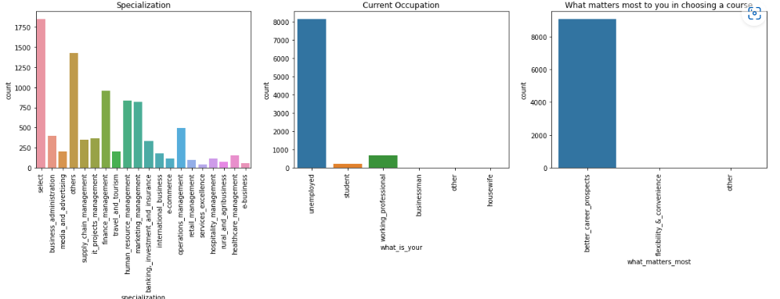
EDA (Univariate Analysis)
In “Specialization column” we can see the majority counts is Others.
In column "What_is_your_current_occupation" we can see that the majority of customers are Unemployed.
In “What matters most” column the priority is better career prospects.

Slide 7
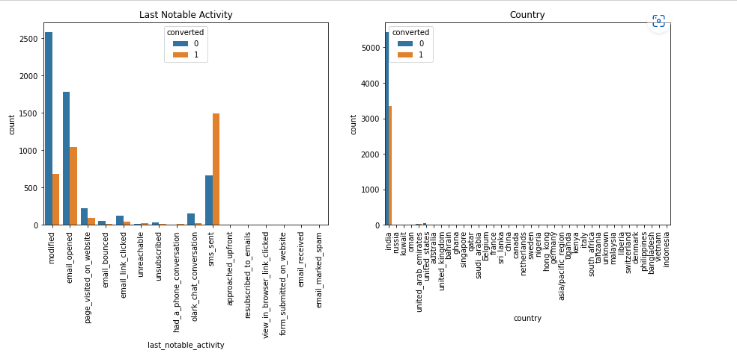
EDA (Univariate Analysis)
Majority of the potential customers are from India and the column country has missing values so dropping this column as this will not be much helpful in Analysis.
We removed outliers by keeping 99 percentile values

Slide 8
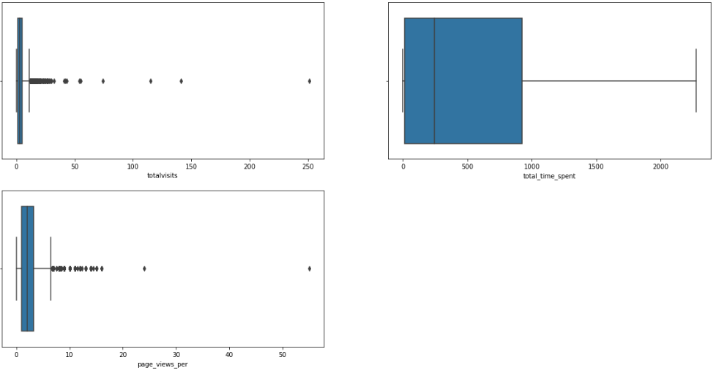
EDA (Univariate Analysis)
• We can see that there are outliers in the column "Total_Time_Spent_on_Website”.
• We can see that there are outliers present in the column "Page_Views_Per_Visit”.
• We can see that there are outliers present in the column "TotalVisits”

Slide 9
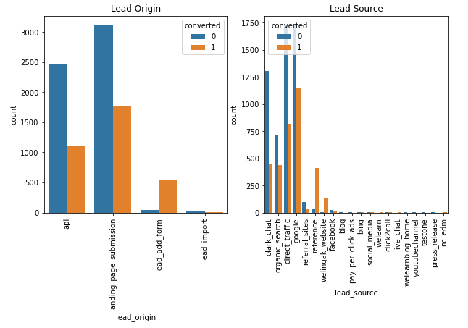
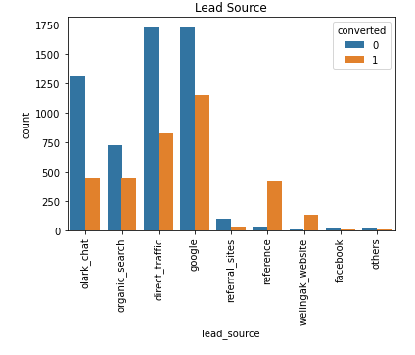
EDA (Bivariate Analysis)
Maximum number of leads are generated by Google and Direct Traffic
Many parameters have less than 5 in counts, combined them as others
API and Landing Page Submission have 30-35% conversion rate but count of lead originated from them are considerable.
Lead Add Form has more than 90% conversion rate but count of lead add form are not very high.
Lead Import are very less in count.

Slide 10
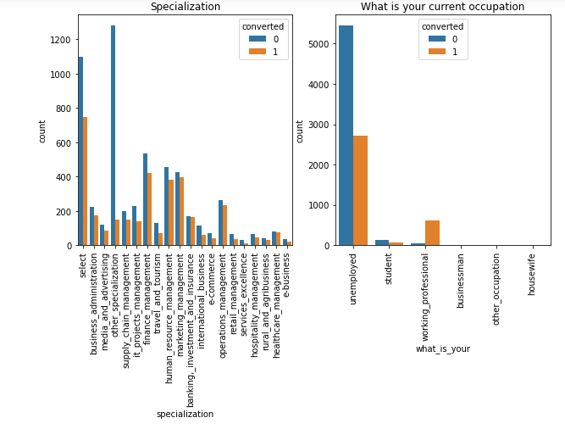
EDA (Bivariate Analysis)
Most number of leads are of Unemployed customers.
Above figure shows that the leads of working professional have high conversion rate
Most leads and conversion rate is high for Other Specialization

Slide 11
Data Preparation
• Converted categorical columns "Do_Not_Email" and "A_free_copy_of_Mastering_The_Interview" with two levels( Yes and No) into numerical columns.
• Created dummy variables and dropped first and original column.
• Removed repetitive columns.
• Did Correlation Analysis on Features through Heat Map.
• Divided Dataset into train and test dataset.
• Utilized Min-max scaler for feature scaling and standardization.

Slide 12
Model Building
The logistic regression model is built for Prediction of lead score.
Used RFE technique for feature selection with 15 variable as output and fined tuned it manually by checking VIF and pValues.
Dropped columns “What_is_your_current_occupation_Housewife”, “Lead_Origin_Lead Add Form”, as these features had high p values/VIF

Slide 13
Model Evaluation
Evaluated the Model Performance by manually using 0.50 cut-off value.
Using ROC Curve, trade off between Sensitivity and Specificity Parameters, established optimal cut-off value of 0.35.
Ran Prediction for Train and Test Data Set---With the Current cut off of 0.35,
Metrics Score on Train Data Set are
Metrics Score on Test Data Set are
1.Accurracy--79.82%
2.Sensitivity--78.82%
3.Specificity--80.46%
4.Precision--71.64%
5.Recall-78.82%
6.True Positive rate--75.06%
7.False Positive Rate--11.72%
8.Positive Prediction Value--78.62%
9.Negative Prediction Value--81.91%
10.F1_Score--75.06%
1.Accurracy--80.38%
2.Sensitivity--81.14%
3.Specificity--81.41%
4.Precision--70.51%
5.Recall-79.06%
6.True Positive rate--80.18%
7.False Positive Rate--18.85%
8.Positive Prediction Value--79.06%
9.Negative Prediction Value--87.17%
10.F1_Score--74.54%

Slide 14
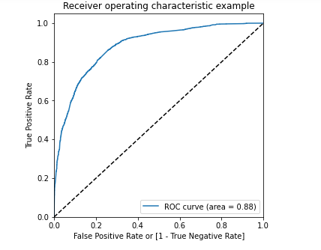
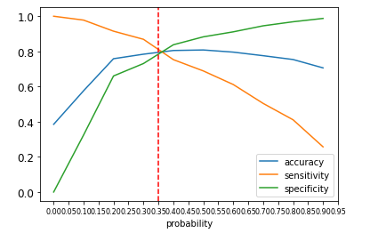
ROC Curve
• Here figure shows that the area under the ROC curve is 0.88 which seems good.
• Found optimal cut-off point at 0.35

Slide 15
Summary
It was found that the variables that mattered the most in the potential buyers are ( Almost In descending order) :
The total time spend on the Website.
When the lead source was:
a. Welingak website
b. Reference
c. Olark chat
When the last activity was:
Phone Conversation
b. SMS
c. Olark chat conversation
When their current occupation is as a working professional.
When the lead origin is Landing page Submission
With all these Observations X Education will be easily able to identify potential leads and convert them into successful buyers.

